Slide 1
Mark 1:14-45

Slide 2
¹⁴ Now after John was arrested, Jesus came into Galilee, proclaiming the gospel of God, ¹⁵ and saying, “The time is fulfilled, and the kingdom of God is at hand; repent and believe in the gospel.”

Slide 3
¹⁶ Passing alongside the Sea of Galilee, he saw Simon and Andrew the brother of Simon casting a net into the sea, for they were fishermen. ¹⁷ And Jesus said to them, “Follow me, and I will make you become fishers of men.” ¹⁸ And immediately they left their nets and followed him. ¹⁹ And going on a little farther, he saw James the son of Zebedee and John his brother, who were in their boat mending the nets. ²⁰ And immediately he called them, and they left their father Zebedee in the boat with the hired servants and followed him.

Slide 4
²¹ And they went into Capernaum, and immediately on the Sabbath he entered the synagogue and was teaching. ²² And they were astonished at his teaching, for he taught them as one who had authority, and not as the scribes. ²³ And immediately there was in their synagogue a man with an unclean spirit. And he cried out, ²⁴ “What have you to do with us, Jesus of Nazareth? Have you come to destroy us? I know who you are — the Holy One of God.” ²⁵ But Jesus rebuked him, saying, “Be silent, and come out of him!”

Slide 5
²⁶ And the unclean spirit, convulsing him and crying out with a loud voice, came out of him. ²⁷ And they were all amazed, so that they questioned among themselves, saying, “What is this? A new teaching with authority! He commands even the unclean spirits, and they obey him.” ²⁸ And at once his fame spread everywhere throughout all the surrounding region of Galilee.

Slide 6
²⁹ And immediately he left the synagogue and entered the house of Simon and Andrew, with James and John. ³⁰ Now Simon’s mother-in-law lay ill with a fever, and immediately they told him about her. ³¹ And he came and took her by the hand and lifted her up, and the fever left her, and she began to serve them.
³² That evening at sundown they brought to him all who were sick or oppressed by demons. ³³ And the whole city was gathered together at the door. ³⁴ And he healed many who were sick with various diseases, and cast out many demons. And he would not permit the demons to speak, because they knew him.

Slide 7
³⁵ And rising very early in the morning, while it was still dark, he departed and went out to a desolate place, and there he prayed. ³⁶ And Simon and those who were with him searched for him, ³⁷ and they found him and said to him, “Everyone is looking for you.” ³⁸ And he said to them, “Let us go on to the next towns, that I may preach there also, for that is why I came out.” ³⁹ And he went throughout all Galilee, preaching in their synagogues and casting out demons.

Slide 8
⁴⁰ And a leper came to him, imploring him, and kneeling said to him, “If you will, you can make me clean.” ⁴¹ Moved with pity, he stretched out his hand and touched him and said to him, “I will; be clean.” ⁴² And immediately the leprosy left him, and he was made clean. ⁴³ And Jesus sternly charged him and sent him away at once, ⁴⁴ and said to him, “See that you say nothing to anyone, but go, show yourself to the priest and offer for your cleansing what Moses commanded, for a proof to them.” ⁴⁵ But he went out and began to talk freely about it, and to spread the news, so that Jesus could no longer openly enter a town, but was out in desolate places, and people were coming to him from every quarter.

Slide 9
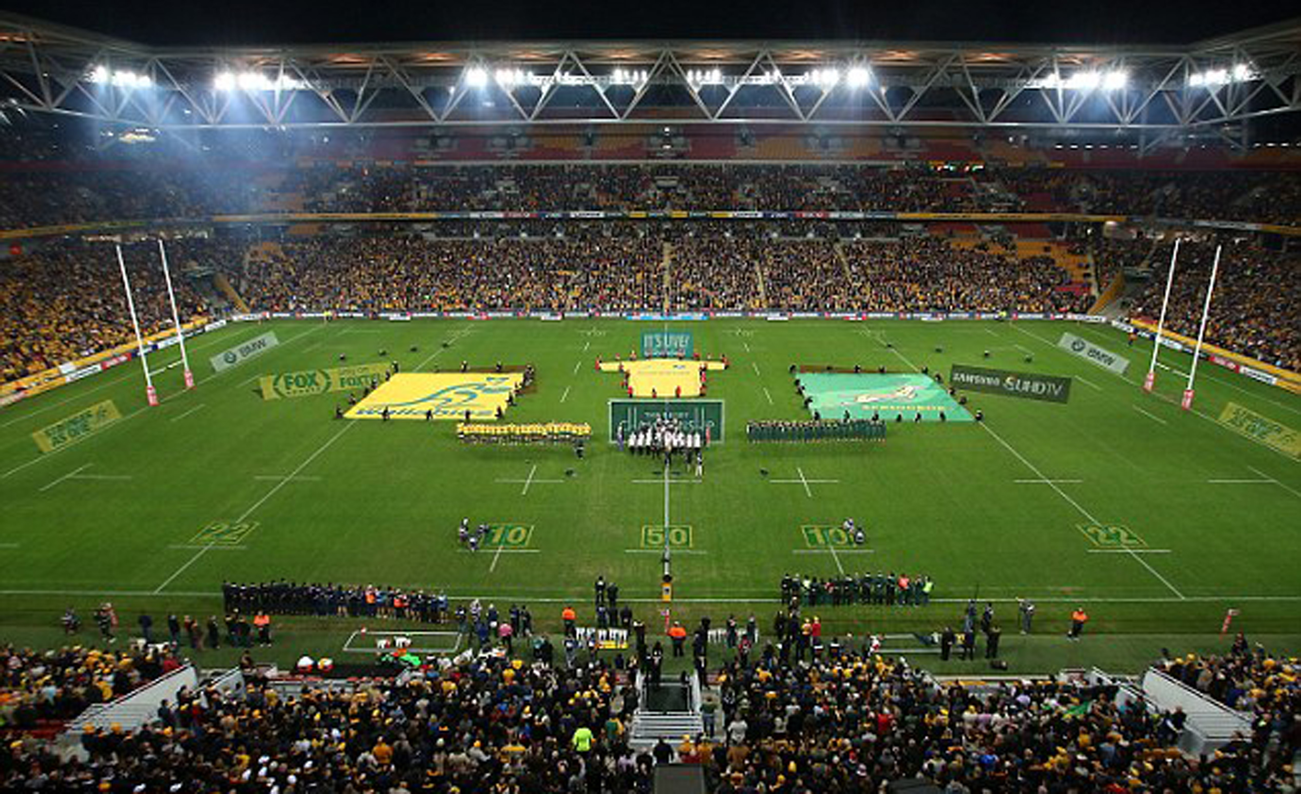

Slide 10
A Disciple of Jesus or A Spectator

Slide 11
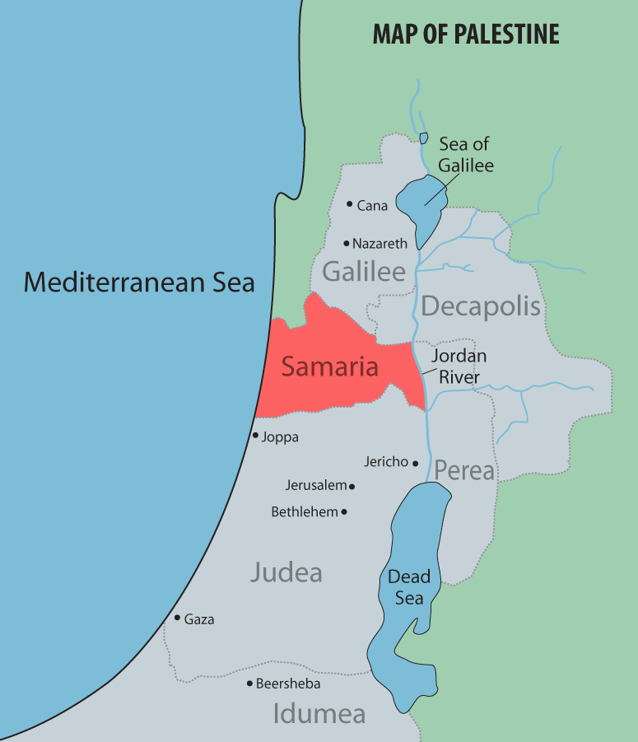

Slide 12
A Disciple of Jesus or A Spectator
^{Mark 1:17} And Jesus said to them, “Follow me, and I will make you become fishers of men.” ¹⁸ And immediately they left their nets and followed him. ¹⁹ And going on a little farther, he saw James the son of Zebedee and John his brother, who were in their boat mending the nets. ²⁰ And immediately he called them, and they left their father Zebedee in the boat with the hired servants and followed him.
When Jesus calls, immediate action is required – Drop everything that we once saw as important, and follow Him

Slide 13
A Disciple of Jesus or A Spectator
When Jesus calls, immediate action is required – Drop everything that we once saw as important, and follow Him (Repent and believe.... Leave and follow....)
Jesus calls us for what He will make us become
If I’m still the same as I was 10 years ago, I’m probably more of a spectator than a disciple of Jesus...
Jesus called country lads, rough, uneducated... To follow Him
Jesus taught with authority – teaching straight from the word of God
Spiritual authority to cast out demons.
When the simple powerful Gospel is proclaimed, Satan tries to disrupt
When the gospel is corrupted (anaemic), pure evil can remain unchallenged)
When the authority of the word of God is preached, we cannot remain ‘unmoved’
Disciples of Jesus Repent.... Enemies of Jesus oppose it and flee....
The work of God will move a spectator to “wonder”, but not to belief
Disciples have a thankful devotion to Jesus
Always take time to Pray
How does Jesus want me to be more of a disciple and less of a spectator?
How is following Jesus, moving me to what He is making me to become?

